Slide 1

Group Project
Group: 01
Submitted by:
Md Sharif Hossain
Rubaida Ferdous
Iftekhar Ahmed Uday
ID: 1712336642
ID: 1711126642
ID: 1711859642

Slide 2
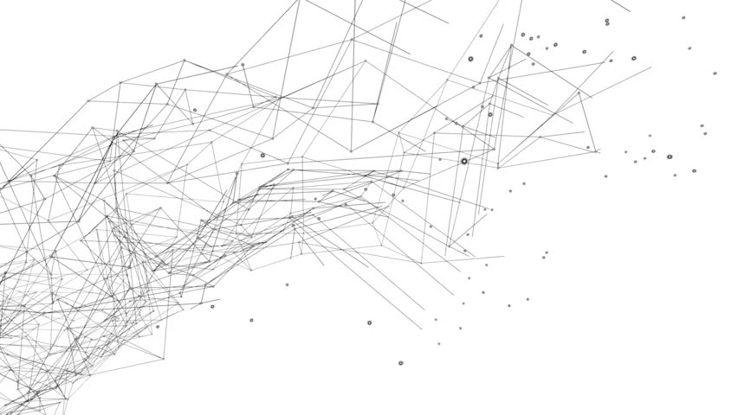
CSE 225L.4
Data Structures and Algorithms
Instructor : Nazmul Hossain
Date: 7th September, 2018
Red-Black Tree Data Structure

Slide 3
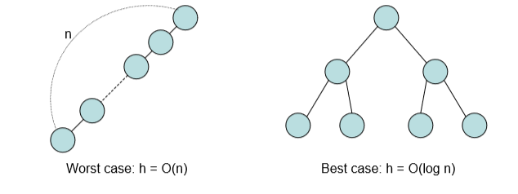
Red Black Tree is a self balanced binary search tree.
Motivation
-The performance of BST is related to its height h
-All the operation in normal BST is O(h)
-Operations of the Red Black tree is O(log n)

Slide 4

Property
Every node is either red or black
2. The root is black
If a node is red, then both its children are black
4. For each node, all path from the node to descendant leaves
contain the same number of black nodes
• All path from the node have the same black height
Every leaf is a NULL node, and is colored black.

Slide 5
Since Red Black Tree is a balanced binary search tree,
It supports:
- Search(tree, key)
- Predecessor(tree, key)
- Successor(tree, key)
- Minimum(tree)
- Maximum(tree) in O(log n)-time
•It also support insertion and deletion with a little bit complicated step

Slide 6
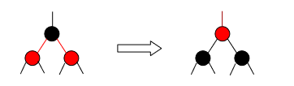
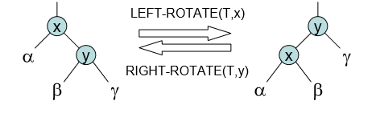
Maintain Property
•Insertion and Deletion will violate the property of red-black tree
•How to maintain the property?
–by Changing Color or Rotation
Changing color
- Rotation

Slide 7
Insertion
•When insert a node z, we set the color of z to red
•This may violate property 2 and 3
•For property 2, we set the color of root to black after insertion
•To fix property 3, we will consider if
–The z’ s parent is a left child or right child
–The color of z's uncle y is red or black
–z is a left child or right child
•We consider the z’ s parent is a left child first, the other case can be done by symmetric operation
There are 4 cases:
•Case 1: y is red and z is a left child
•Case 2: y is red and z is a right child
•Case 3: y is black and z is a left child
•Case 4: y is black and z is a right child

Slide 8
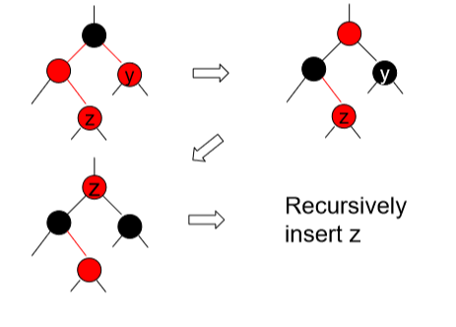
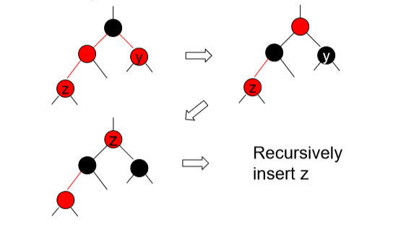
Case 1: y is red and z is a left child
Case 2: y is red and z is a right child

Slide 9
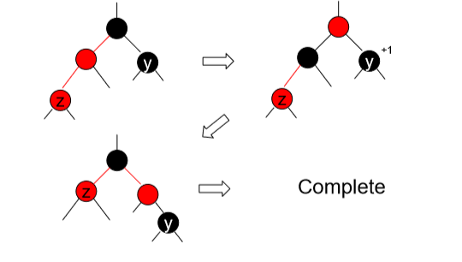
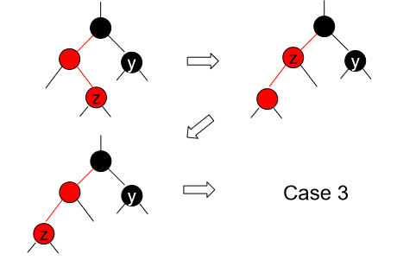
Case 3: y is black and z is a left child
Case 4: y is black and z is a right child

Slide 10
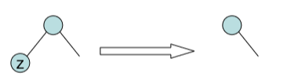
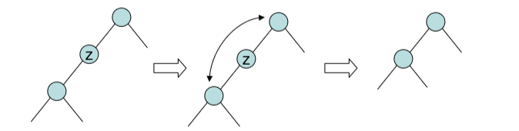
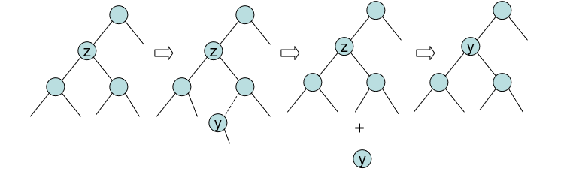
Deletion
•To delete a node z, there are 3 cases
Case1: z has no child
Case 2: z has one child
Case 3: z has two children

Slide 11
Deletion
•From now on, we always call the deleted node to be z
•If z is red, it won't violate any property
•If z is a leaf, it won't violate any property
•Otherwise z is black and has a child, it will violate property 2, 3, and 4
•For property 2, set the color of root to black after deletion
To fix property 3 and 4:
- If z's child x (which is the replacing node) is red, set x to black. Done!
- If x is black, add another black to x, so that x will be a doubly black node, and property 3 and 4 are fixed. But property 1 is violated
•To fix property 1, we will consider if
–x is a left child or right child
–The color of x's sibling w is red or black
–The colors of w's children
•We consider x is a left child first, the other case can be done by symmetric operation

Slide 12
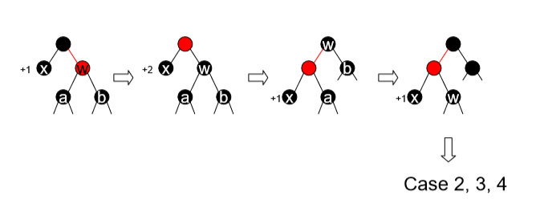
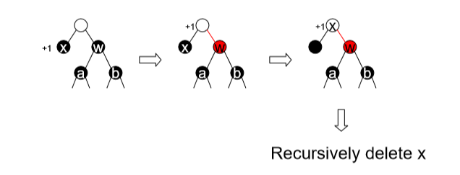
Deletion
Case 1: w is red
Case 2: w is black, both w’ s children are black

Slide 13
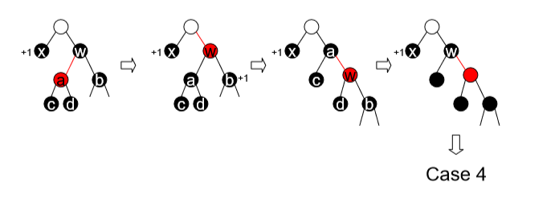
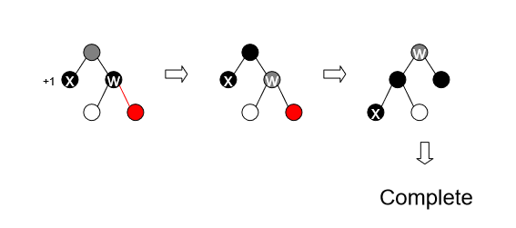
Deletion
Case 3: w is black, w’ s left child is red, w’ s right child is black
Case 4: w is black, w’ s right child is red

Slide 14
Conclusion
Red-Black Tree is a balanced binary search tree which supports the operation search, find predecessor, find successor, find minimum, find maximum, insertion and deletion in O(log n)-time.
Thank You, Sir

